Slide 1
Machine Learning Models and Dataset Versioning

Slide 2
$ whoami
Open source contributor DVC, CloudCV,
FOSSASIA OpenTechNights Winner
ML intern @Neuroplex
ML and AI enthusiast
Final year Compute scinece student @ MEC

Slide 3
Outline
Why ML is different from software engineering?
Problems on using git
Problems with git-LFS
Current workflow for ML models management
Use case as application- Cats vs Dogs model
Conclusion

Slide 4
What is ML?
It provides an systems the ability to automatically learn and improve from experience without being explicitly programmed.
(supervised, unsupervised, RNN)

Slide 5
How ML is different?
Data science as different from software
as software was different from hardware.
                - Nick Elprin
The rise of Software engineering required inventing new processes like version control, code review, agile, to help teams work effectively. The rise of AI & Machine Learning is now requiring new processes, ..
- Andrew Ng

Slide 6
Key Differences
ML is metrics driven
Enormous size of data and models
Sharing of Models with teams
Special purpose hardware
Pipelines
Difference in best practises

Slide 7
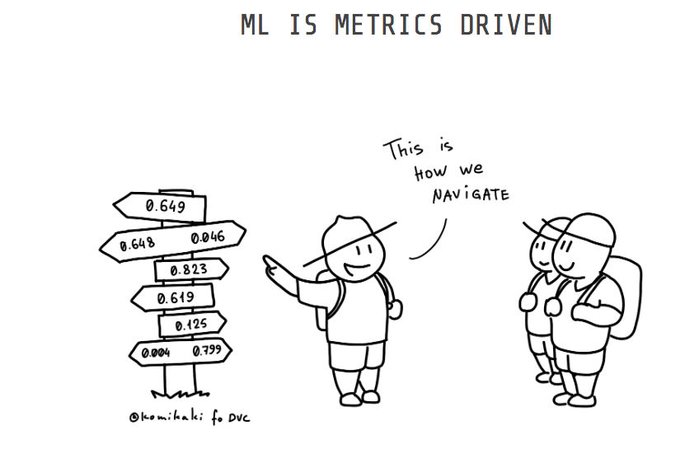
ML is metric driven
We focus on improving metrics like accuracy, AUC, RUC.
Aim to make SOTA models, rapidly experiment

Slide 8
Feature-driven Development
While in software engineering, your team works by building new features.
Use code-review and agile best practises.

Slide 9
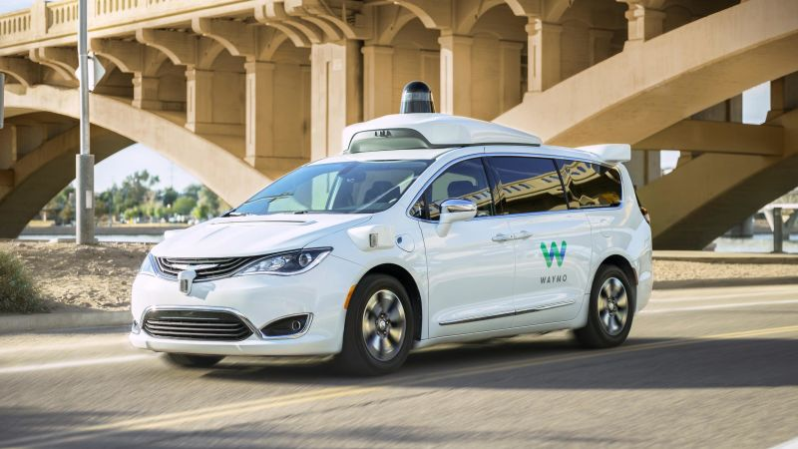
Huge amount of Data dealed
People work with TB’s of data for everything.
Managing datasets are a problem

Slide 10
Huge amount of Data dealed
People work with TB’s of data for everything.
Managing datasets are a problem
Imagine the amount of data generated for a self-driving car

Slide 11
Sharing of Models with Teams
Reproducing results on process and team is usually such a pain taking task.
Making changes in each period is very useful
Collabrative challenges faced by teams

Slide 12
Pipelines of different stages
Defining process of steps at each duration like:
- Training
- Feature extraction
- Classification
- Final output

Slide 13
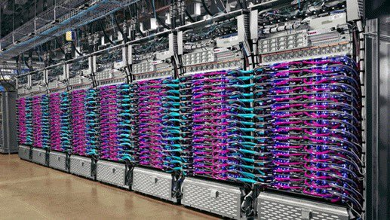
Special purpose hardwares
Use of special TPUs and cloud Computing

Slide 14
Language conventions
Use of Python3 pep8 conventions are not always properly practised.
from fastai import *
Try to make everything a black box

Slide 15

Using git for large dataset
Trying git for dataset of size of 1GB takes about 8-10 minutes to commit
.gitignore – ignores Dataset versioning

Slide 16
Using git-LFS
“Git Large File Storage (LFS) replaces large files such as audio samples, videos, datasets, and graphics with text pointers inside Git, while storing the file contents on a remote server like GitHub.com or GitHub Enterprise.”

Slide 17
Using git-LFS
There is a data limit of storing files of 2GB, which is a github limitation.
Another issue is the ease of placing data files on a cloud storage system (AWS, GCP, etc) as is often required when to run cloud-based AI software.
Not designed in mind with ML/data science

Slide 18
How do teams manage ML Projects?
Without no ML and data versioning

Slide 19
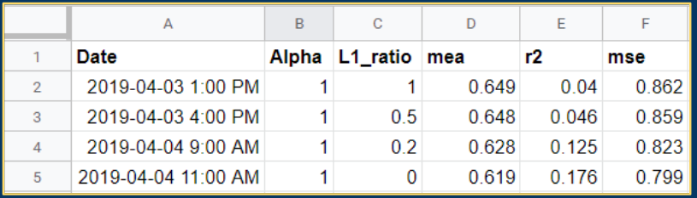
Tracking results in CSV file
Use spreadsheets to track metrics and outcoms
Track multiple models effectively
Fails to track end to end approach, conda environments

Slide 20
Annotated notebooks
Heavily documented jupyter notebooks, with each Model being explained in depth
Easy to follow through
Eg: Kaggle kernel of argtor

Slide 21

Other open source tools
Data Version Control – Track experiments, data
ML flow – Metric Tracking, Model Deployment
Neptune.ml – Experiment Tracking, collabration
Jovian – Share notebooks, easily reproducible

Slide 22
Why DVC is a good option?
It’s open source
Support for:
a) Pipelines
b) Versioning ML models
c) Versioning Datasets
d) Tracking metrics

Slide 23
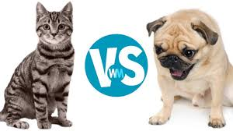
Using DVC with a problem
We are going to work on a Classic Deep Learning problem like cats vs dogs:
# initialising project
$ git clone https://github.com/iterative/example-versioning.git
$ cd example-versioning

Slide 24
1. Add the data to dvc
We use 1000 labelled images of Cats and dogs at first
$ dvc add data Add datafolder to dvc
$ python train.py
$ dvc add model.h5 model is add to dvc

Slide 25
2. Track changes with git
$ git add .gitignore model.h5.dvc data.dvc metrics.json
$ git commit -m "First model, trained with 1000 images"
$ git tag -a "v1.0" -m "model v1.0, 1000 images"

Slide 26
3. Push changes to cloud
$ dvc push
$ dvc pull
Data is pushed to remote server from local cache.
DVC is storage agnostic and support s3, Azure, GCP, hdfs, ssh

Slide 27
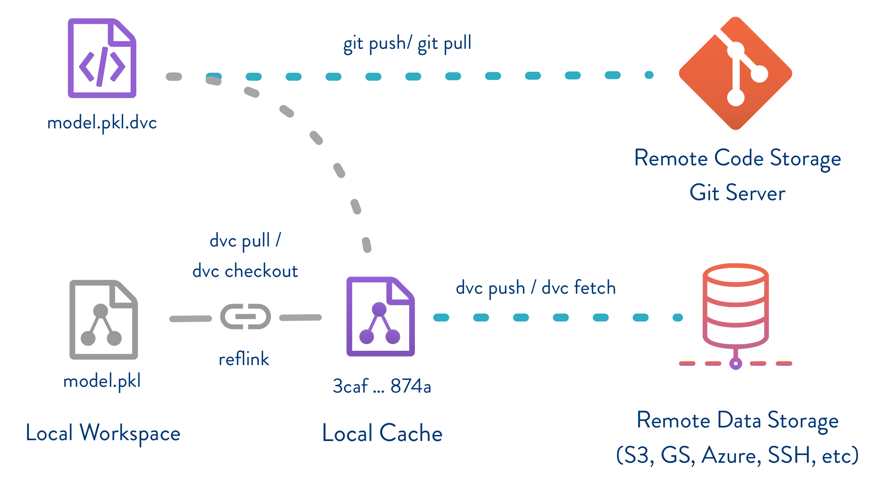

Slide 28
4. Adding more labelled data
(downloading 1000 more images of labelled cat and dog images)
$ dvc add more_data
$ dvc remove model.h5.dvc
$ python train.py
$ dvc add model.h5

Slide 29
$ git add model.h5.dvc data.dvc metrics.json
$ git commit -m "Second model, trained with 2000 images"
$ git tag -a "v2.0" -m "model v2.0, 2000 images"

Slide 30
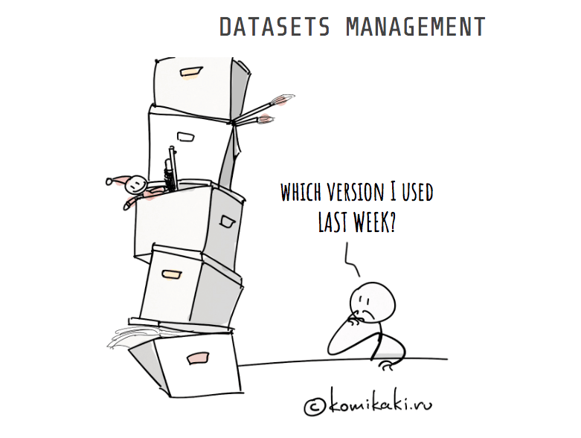
What is Dataset versioning?
Tracking of data at each time
Data is new oil
When working with TB’s of data it’s essential
Different splits for train/test/val

Slide 31
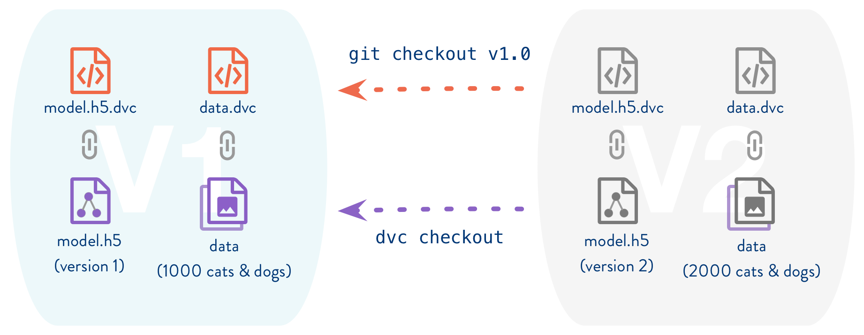
Switching between versions
$ git checkout v1.0
$ dvc checkout

Slide 32
Running experiments
$ dvc pull data_folder.dvc
$ dvc run <parameters>
DVC is internally building a dependency graph using dependencies, output and stores the result.

Slide 33
dvc run -f modelDvcfile \
-d train.py -d data \
-M metrics.json \
-o model.h5 \
-o bottleneck_features_train.npy \
python train.py

Slide 34
d for dependency: specify an input file
o for output: specify an output file ignored by git and tracked by dvc
M for metric: specify an output file tracked by git
f for file: specify the name of the dvc file.

Slide 35
Model versioning
Models = Code + data + hyperparameters
Everytime our hyperparameters are changed, we can have corresponding DVC files with store the changes
You can even reproduce the old results

Slide 36
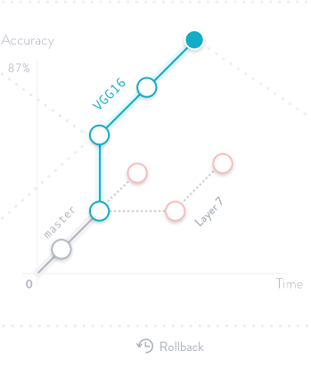
I use VGG architecture for version1
Then resnet for version2
V2 made much more improvements by using Bottle-necks
Fine tune models

Slide 37
Reproduce results
$ dvc repro train_v2.dvc
$ dvc metrics show

Slide 38
ML Reproducibilty crisis
Much of ML projects are not reproducible
Usually build by single person, and configured according
Data + ML Models involved

Slide 39
Questions

